Slide 1
Is Rising Population Growth a Global Concern?
Candidate number: 2313

Slide 2


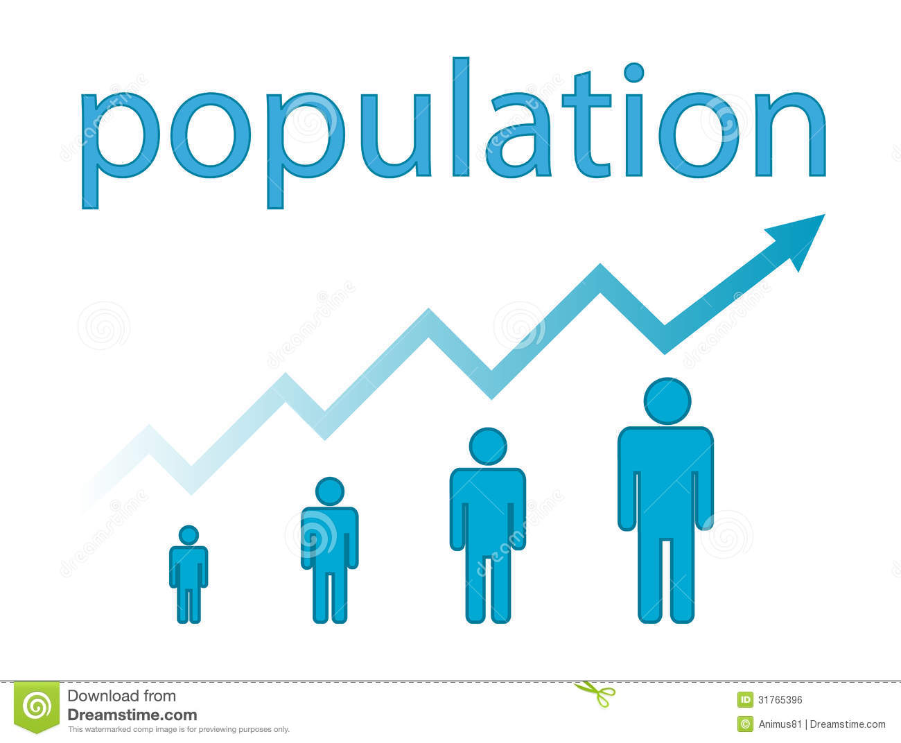
Group thesis/ My thesis
Group thesis: A rising population growth is a global concern, considering that the environment, health, and economics will all be affected negatively with the increase in population.
Personal thesis: A rising population growth can negatively affect our economy. However, a growth in population leads to temporary economic growth.
http://www.mywakulla.com/visitors/about_wakulla/population_and_demographics.php
http://www.dreamstime.com/photos-images/population.html
http://worldpopulationhistory.org/map/1/mercator/1/0/25/

Slide 3



Group’s Different Perspectives
https://www.bartlett.ucl.ac.uk/sustainable/sustainable-news/GECP_newreport
https://internationalmedicalcorps.org/programs/mental-health
http://ukhse.org/award-in-environmental-awareness/
All will be affected with a rising population growth

Slide 4
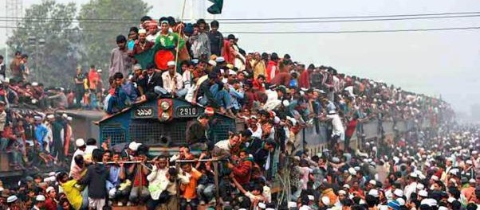
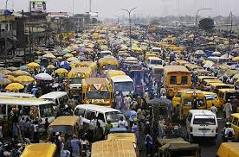
My standpoint: Economics
http://www.cnn.com/2007/TECH/science/09/25/overpopulation.overview/index.html?eref=rss_tech
S, T. (2015, January 23). Overpopulation: Oh shut up! Retrieved April 28, 2016, from http://brightonleft.org.uk/2013/01/22/overpopulation-oh-shut-up/

Slide 5


My Reasons
Major economic/tax reforms in government
Limited food and resources
http://news.heartland.org/newspaper-article/2014/11/18/pennsylvania-tax-reform-gains-support-statehouse
http://midelmanagement.com/media/living-within-your-limited-resources/

Slide 6



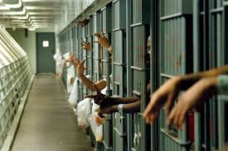

Major economic/tax reforms
Rising growth in population
http://health.gsu.edu/services/primary-care/
https://education.wsu.edu/graduate/specialed/phd/
Higher demand for public services by the government
http://zombie.wikia.com/wiki/Hospitals
https://nottmagazine.com/2015/05/23/why-and-how-do-we-jail-criminals/
Higher taxes
http://worldartsme.com/money-sign-clipart.html#gal_post_5975_money-sign-clipart-1.jpg

Slide 7
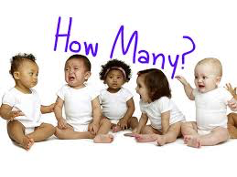
Tax credits for each child born
http://www.playbuzz.com/arielw/how-many-kids-should-you-actually-have
National deficit
Higher tax cuts
Increase in population

Slide 8
Lack of food and resources
Resources
Population

Slide 9
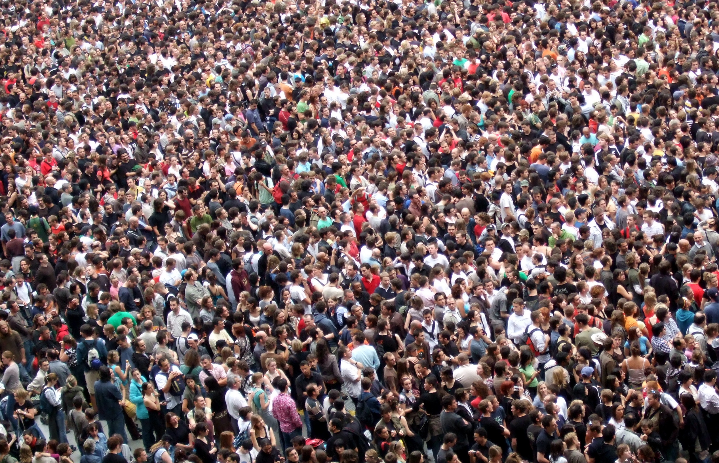

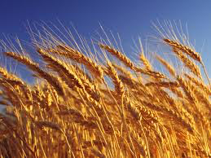

https://www.flickr.com/photos/jamescridland/613445810
https://pixabay.com/en/photos/water/
http://www.thetablebellingham.org/2013/06/the-riddle-of-the-bread-tree/grain/
http://www.mawaridegroup.com/oilgas.php

Slide 10
Counter-argument/ My perspective
Rising population growth
Rising population growth
National spending
Economic collapse
Finite food and resources
Higher taxes
Temporary economic growth

Slide 11


Solution
Education
Family planning- defined as the regulation of the number of offspring through the use of birth control.
http://www.modernmom.com/2c29a41c-051f-11e2-9d62-404062497d7e.html
http://bchdmi.org/cchs/family_planning

Slide 12
References
BRITISH International Safety Organisation | Award in Environmental Awareness. (2015). Retrieved May 13, 2016, from http://ukhse.org/award-in-environmental-awareness/
Guru, S. (2014). Population Growth and Economic Development of a Country. Retrieved April 20, 2016, from http://www.yourarticlelibrary.com/economics/population-growth-and-economic-development-of-a-country/38275/
INTERNATIONAL MEDICAL CORPS. (2015). Mental Health and Psychosocial Support. Retrieved May 13, 2016, from https://internationalmedicalcorps.org/programs/mental-health
Mills, R. (2012, June 6). Resource Scarcity and Population Growth. Retrieved April 20, 2016, from http://www.financialsense.com/contributors/richard-mills/resource-scarcity-and-population-growth
Oil & Gas. (n.d.). Retrieved May 03, 2016, from http://www.mawaridegroup.com/oilgas.php
Pimentel, D. (1996, February 9). IMPACT OF POPULATION GROWTH ON FOOD SUPPLIES AND ENVIRONMENT. Retrieved April 20, 2016, from http://www.dieoff.com/page57.htm
Policies to green the economy must underpin UK recovery: New report. (2014, February 24). Retrieved May 13, 2016, from https://www.bartlett.ucl.ac.uk/sustainable/sustainable-news/GECP_newreport

Slide 13
Salaam, D. E. (2015, July 3). Tax Reforms Are Necessary To Help Tanzania Finance Development and Solidify Economic Growth. Retrieved April 20, 2016, from http://www.worldbank.org/en/news/press-release/2015/07/03/tax-reforms-are-necessary-to-help-tanzania-finance-development-and-solidify-economic-growth
Wilhoit, S. (2016). Reduce Overpopulation and National Debt by Ending Tax Incentives for Having More than Two Children. Retrieved April 20, 2016, from https://forcechange.com/55447/reduce-overpopulation-and-national-debt-by-ending-tax-incentives-for-having-more-than-two-c
hildren/
White, A. (2014, September 08). How Many Kids Should You Actually Have? Retrieved May 03, 2016, from http://www.playbuzz.com/arielw/how-many-kids-should-you-actually-have
Walters, A. (2013, June 04). Grain. Retrieved May 03, 2016, from http://www.thetablebellingham.org/2013/06/the-riddle-of-the-bread-tree/grain

